Slide 1

IDExport tool source introduction
SAP Active Global Support 18th April 2017

Slide 2
Overview
This tool can export Integration Directory contents into HTML format to a local file folder using Integration Directory API.
It may be helpful when we deliver services while Integration Directory access is not possible.
It can also work through OSS remote HTTP connection inside SAP network.
Note: if you deliver remote service for Java only PI system, NWDS is an even better choice to access both ESR and ID contents (system and integration flow). But you can also use this tool to have an offline copy.

Slide 3
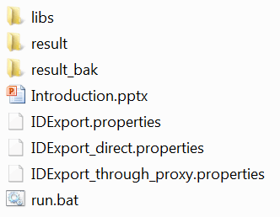
Folder structure for the tool – parent folder
Java support Jar file folder
ID content result folder. You can copy this folder any where for display.
Empty result folder
This introduction slide
Runtime configuration file
Runtime configuration file template
Execution command file

Slide 4
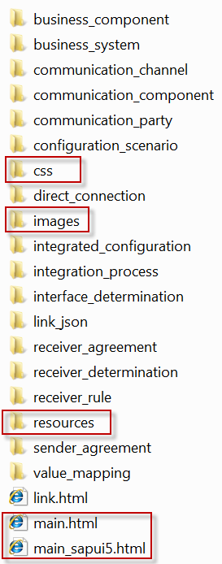
Folder structure for the tool – result folder
Dynamic Generated ID contents folder (non highlight ones)
Support static resource folder (highlight ones)
Dynamic Generated plain HTML tree file
Plain HTML version main page
SAPUI5 version main page. Must be opened with supported browser, like firefox.
All file or folders highlighted shouldn’t be deleted. Others should be deleted before each run.
There is a copy for highlighted contents in result_bak folder

Slide 5
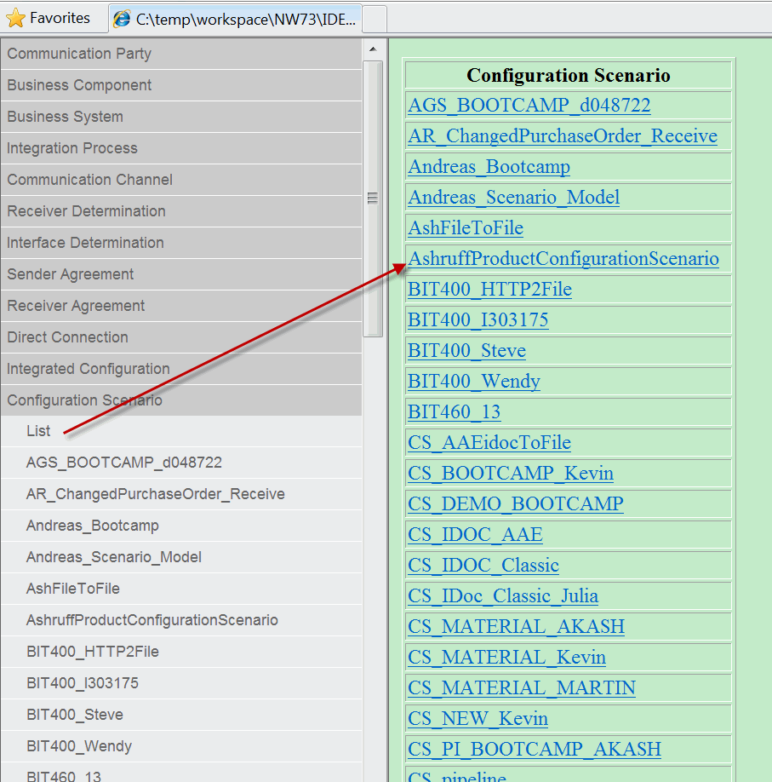
Plain HTML version of result – main page
Left side is objects navigation tree.
You can open each tree node.
First element (List) of the tree node shows a object list.
You can navigate to object detail either by click the link in navigation tree, or in the content list.

Slide 6
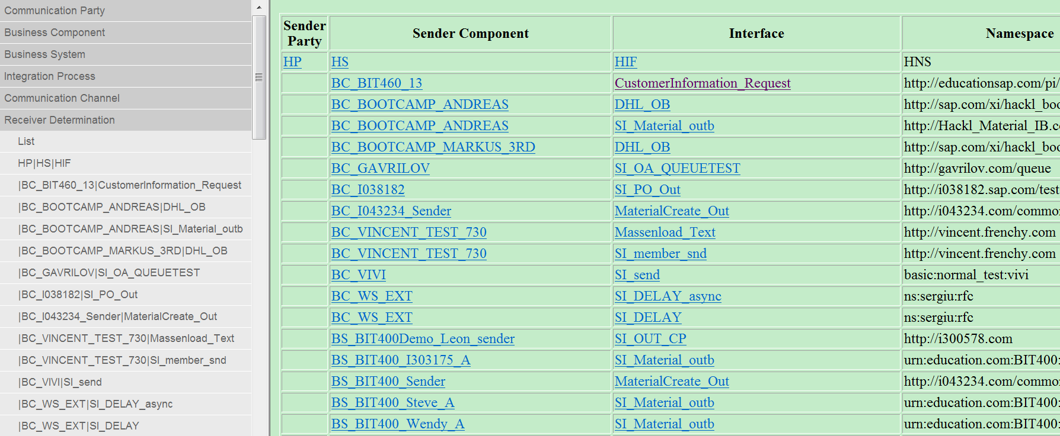
Plain HTML version of result – links
The links for party, component, channel will navigate you to these objects.
The links for interface will navigate you to receiver determination, interface determination, sender agreement, receiver agreement, direct connection, integrated configuration.

Slide 7
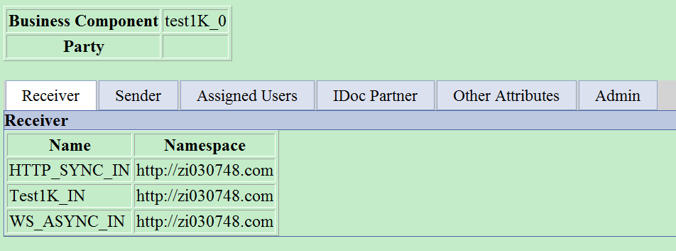
Plain HTML version of result – party, communication components
You can get contents in each tab. You can compare with ID GUI if you can’t get the meaning from attribute’s name.

Slide 8
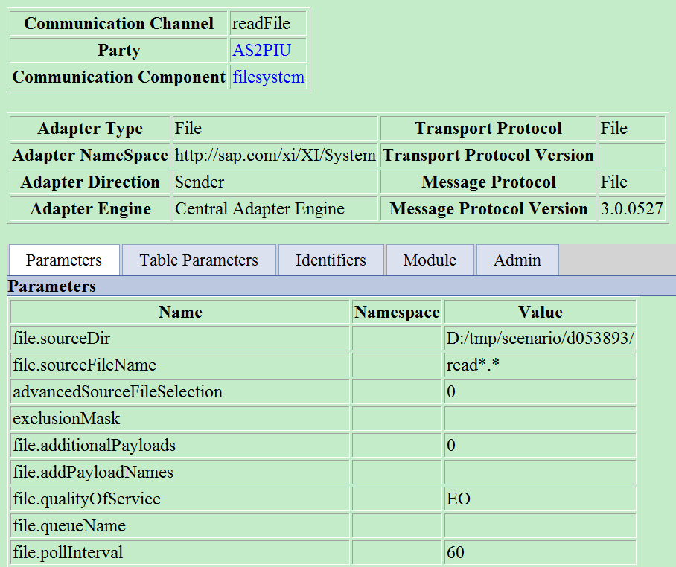
Plain HTML version of result – communication channel
The main difference from the real ID GUI is that all attributes are displayed as a list of parameters. You should match them with GUI element.

Slide 9
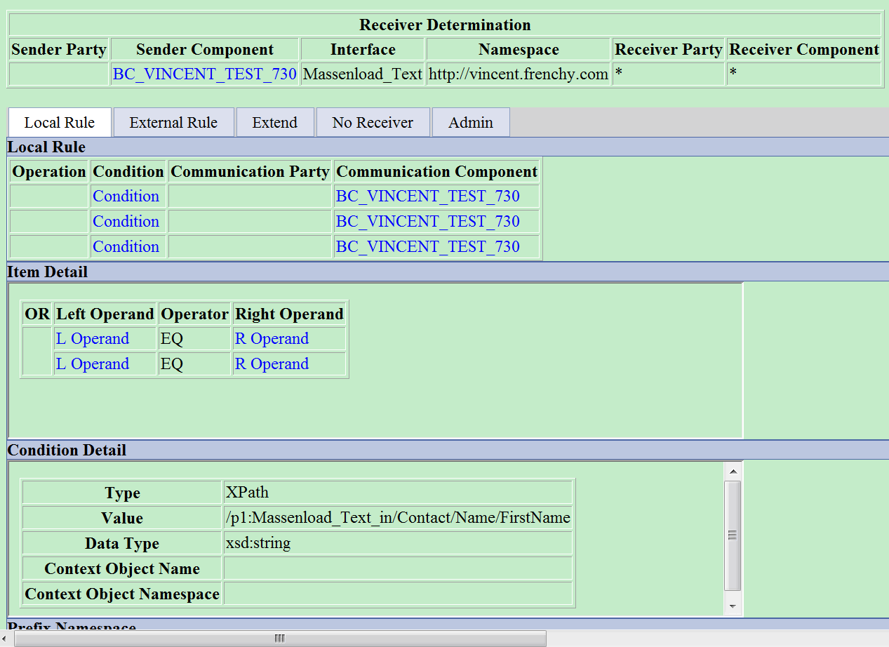
Plain HTML version of result – receiver determination, interface determination
External Rule lists the referenced rule name.
Extend shows dynamic receiver determination mapping program detail
No receiver shows “no receiver found” configuration.
Local Rule displays the condition and receiver. Click condition link will show operator / operand list together with AND / OR relationship. Click Operand link will show operand detail. Click operation mapping will show mapping program detail.

Slide 10
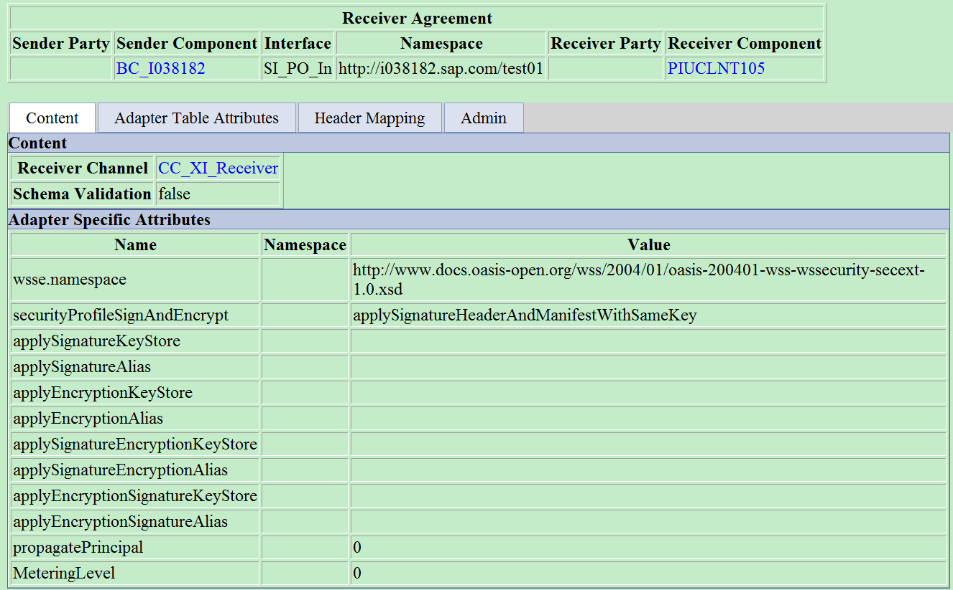
Plain HTML version of result – sender / receiver agreement, direct connection
This page shows the adapter attributes, header mapping and other information.

Slide 11
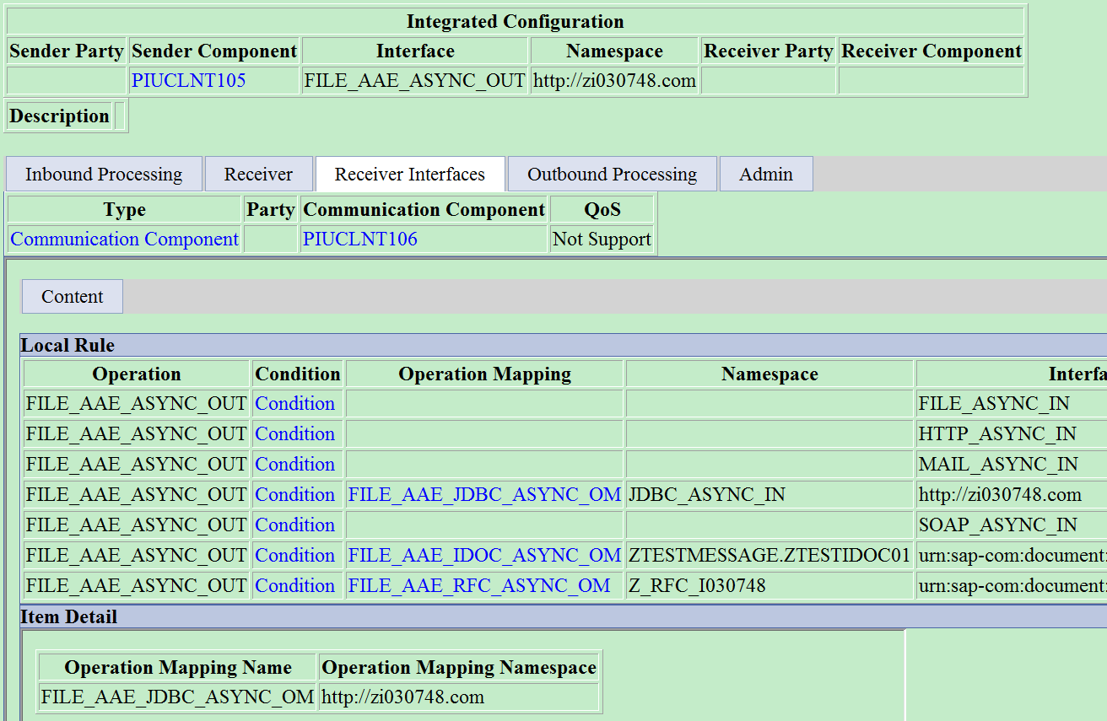
Plain HTML version of result – integrated configuration
This is similar like other objects.
If you click second level tabs, you need to scroll up to see the header information.

Slide 12
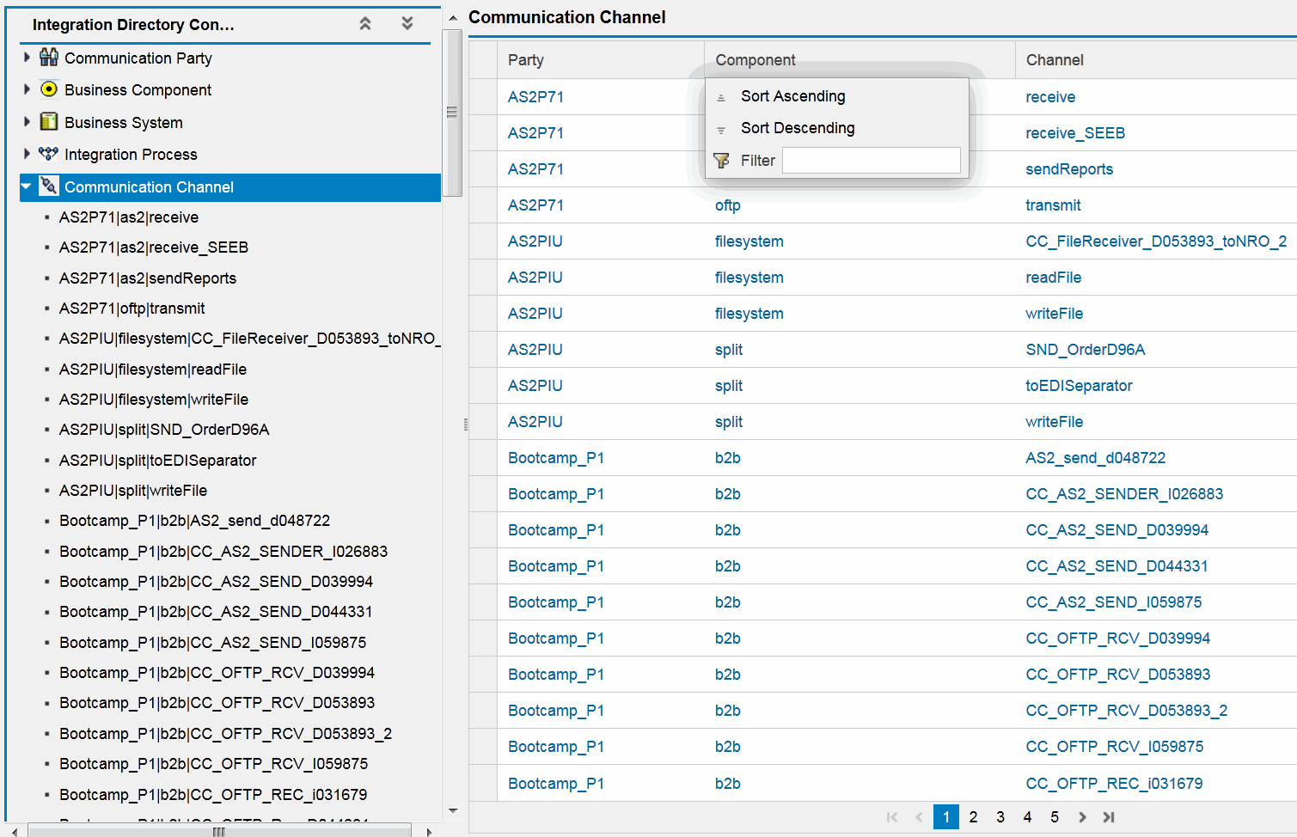
SAPUI5 version of result – main page
Click node object in navigation tree can show the object list.
Common table functions like sorting, filtering, page display are supported in SAPUI5 library.

Slide 13
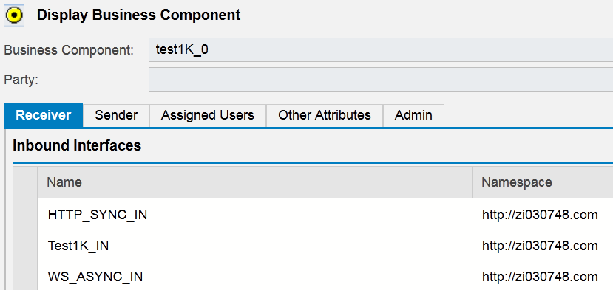
SAPUI5 version of result – party, communication components
Similar like plain html version, but even colorful with SAPUI5 library support. Table include also support sorting, filtering functions.

Slide 14
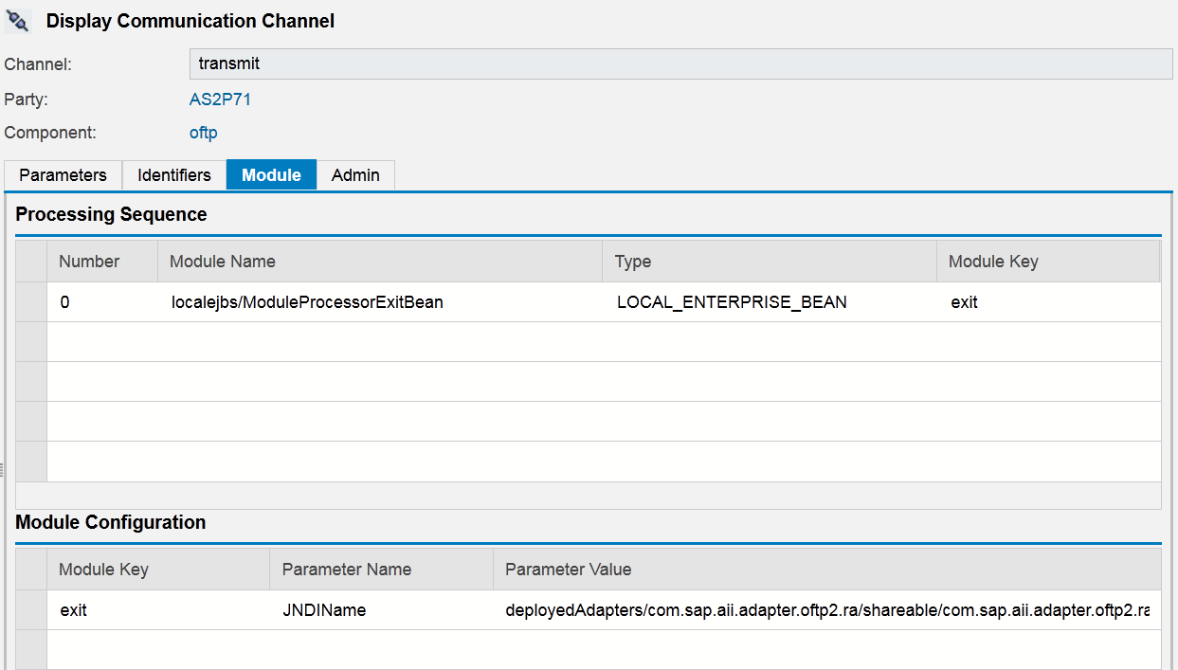
SAPUI5 version of result – communication channel
Similar like plain html version, but even colorful with SAPUI5 library support.

Slide 15
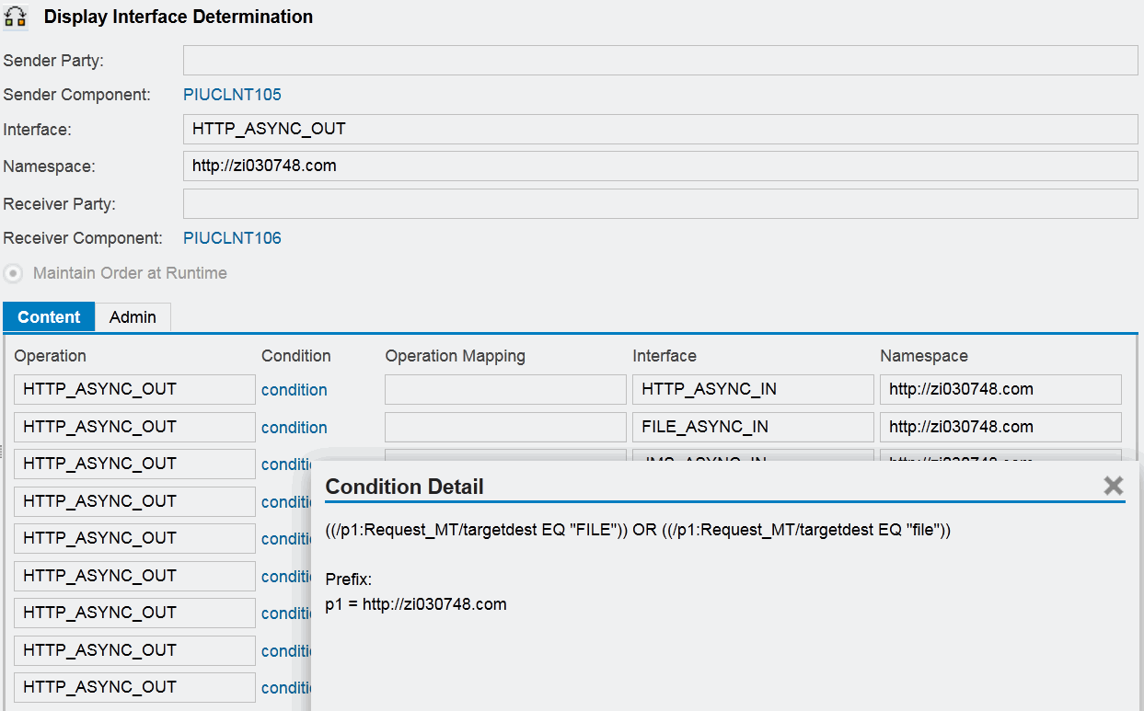
SAPUI5 version of result – receiver determination, interface determination
When click condition / operation mapping, system will show detail in pop up window.

Slide 16
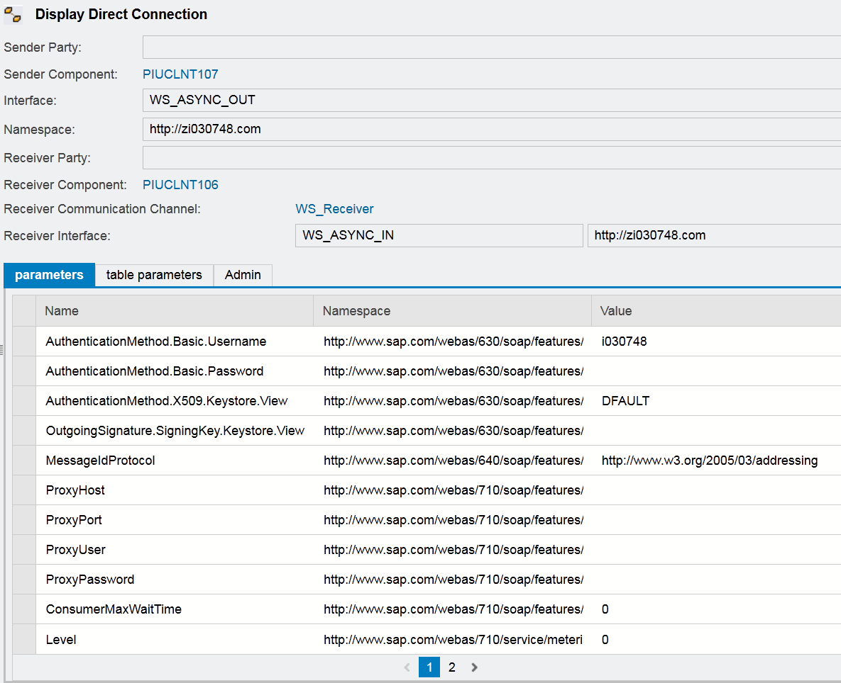
SAPUI5 version of result – sender / receiver agreement, direct connection
Similar like plain html version, but even colorful with SAPUI5 library support.

Slide 17
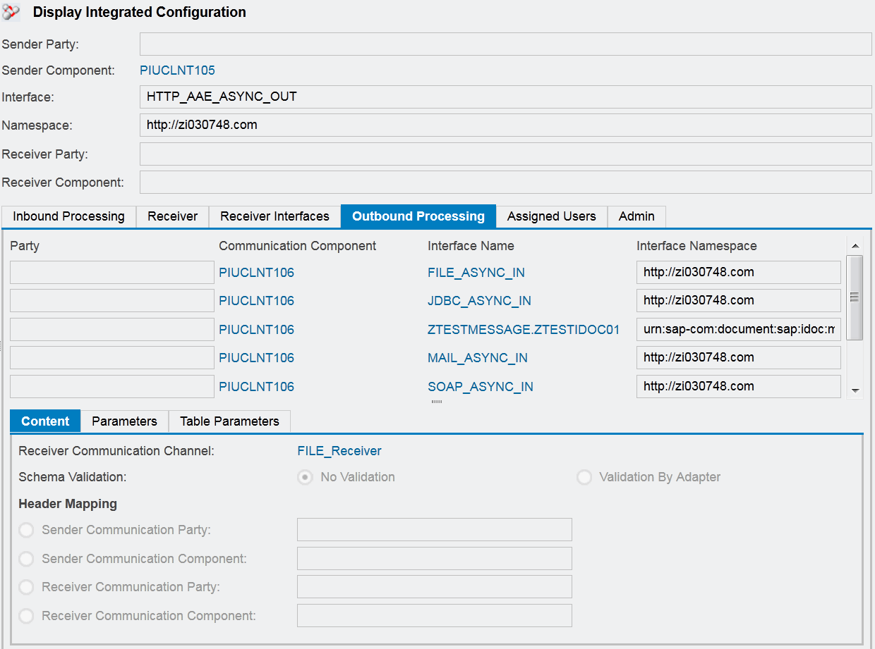
SAPUI5 version of result – integrated configuration
Similar like plain html version, but even colorful with SAPUI5 library support.

Slide 18
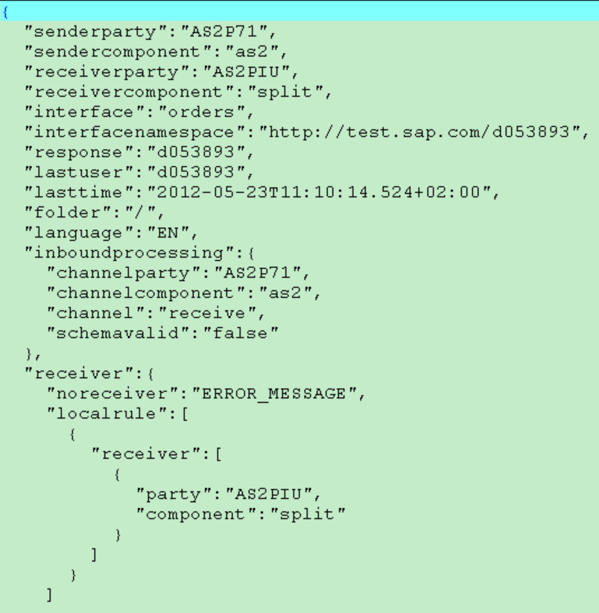
SAPUI5 version of result – JSON source file
In sub folders, there are *.json files, which is the content for objects.
If there are problem in GUI display, you can check the content in these files.
You can also use file content search tool to make search.

Slide 19
How to use it – configuration file
IDExport.properties is the configuration file
Parameter | Meaning | Comment
host | PI system URL | http://<host>:<port>
user | PI user | Have role: SAP_XI_API_DISPLAY_J2EE
password | PI user password
proxy_host | Proxy host name | After remote HTTP connect to system via
proxy_port | Proxy port | STFK, SAP GUI window have proxy host,
proxy_user | Your I- / D- number | port, user, password information.
proxy_password |  | For direct connection, leave them empty.
bundle_size | How many objects to get in one call | For large system, increase value to decrease the total run time.

Slide 20
How to use it – configuration file
IDExport.properties is the configuration file
Parameter | Meaning | Comment
export_CommunicationChannel | If export … to csv file | true or false
export_SenderAgreement | If export … to csv file | true or false
export_ReceiverAgreement | If export … to csv file | true or false
export_InterfaceDetermination | If export … to csv file | true or false
export_IntegratedConfiguration | If export … to csv file | true or false

Slide 21
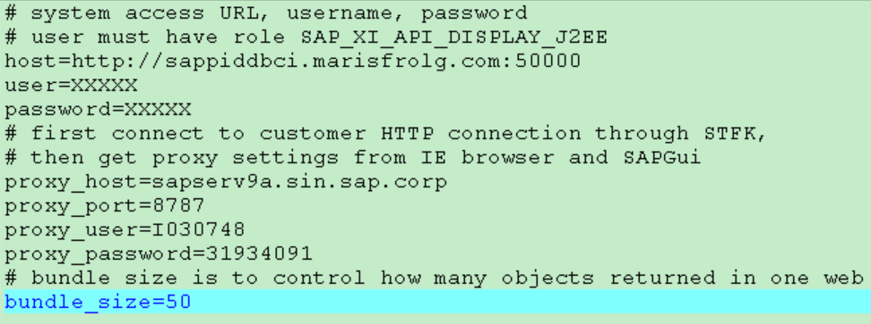
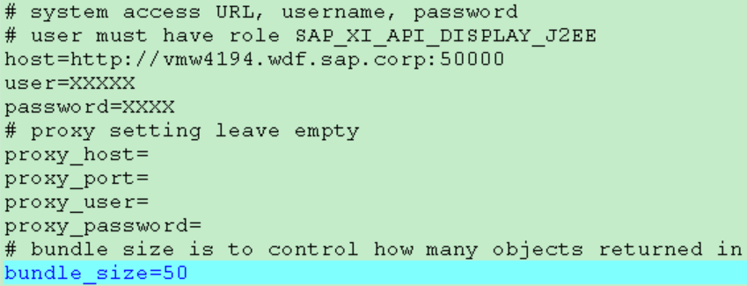
How to use it – configuration file template

Slide 22
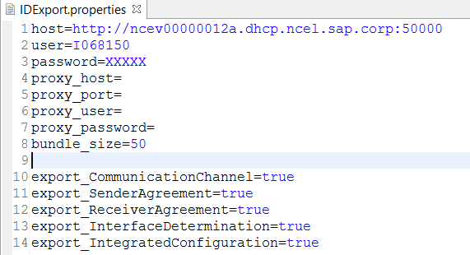
How to use it – configuration file template

Slide 23
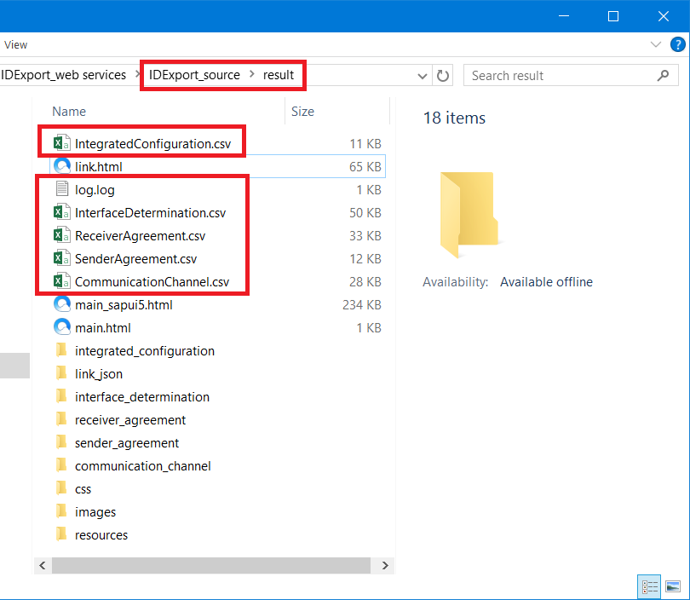
How to use it – configuration file
Genarated csv files and log file will be placed under “result” folder

Slide 24
How to use it – prepare the folder
Delete all the contents that not highlighted in previous slide in result folder.
You can use result_bak folder for reference.
If you leave the generated folders and files for last running, they will be overwritten if generated file name is the same. But this doesn't affect result html / SAPUI5 display.

Slide 25
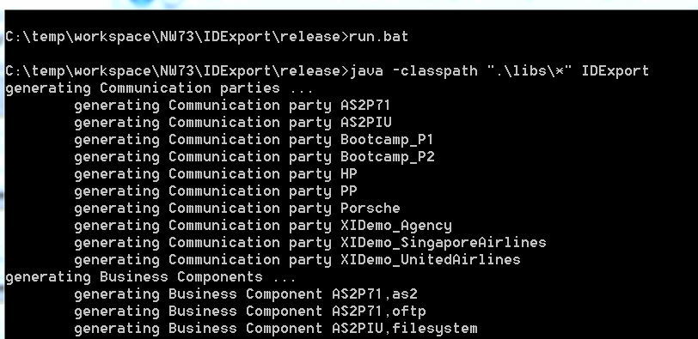
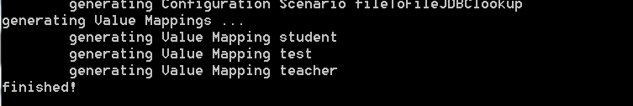
How to use it – execute run.bat

Slide 26
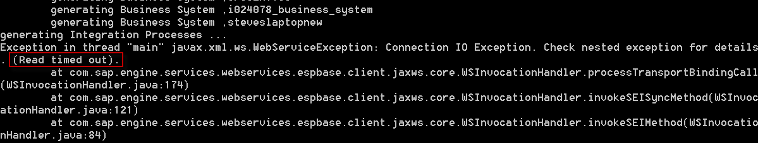
How to use it – time out exception
Time out exception is mainly because system first time execution of a web service call.
You can run the command again.
You can also run each web service call in WS Navigator manually in advance to avoid first time execution time out exception.

Slide 27
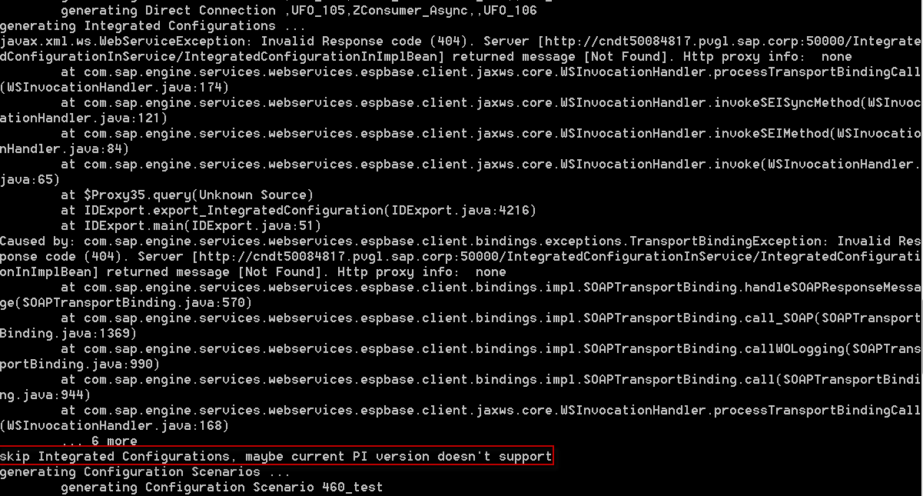
How to use it – web service exception
Low version PI doesn’t support some API, especially for receiver rule, integrated configuration. Program has exception handling, but report it in output.
You can ignore these exceptions.

Slide 28
How to use it – other exception
If you find “ No class found” exception, please report the class name. Some NW library Jar files should be missing in libs folder, and need to put there.
Other exceptions should be caused by program bug, please report to me the exception stack trace.
If you see error information or empty page in SAPUI5 GUI, please report to me the whole result folder (except the static contents which is too big).

